Slide 1
Entity Relationship(ER) Diagram

Slide 2
ER-Diagram
An entity-relationship diagram is a data modeling technique that creates a graphical representation of the entities, and the relationships between entities, within an information system.

Slide 3
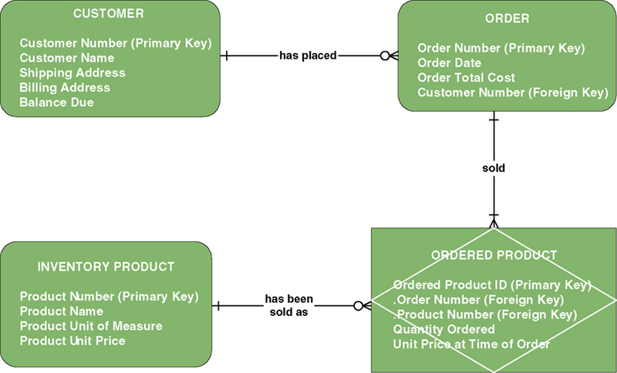
Sample ER-Diagram

Slide 4
Purpose of ERDs
An E-R Diagram shows a database’s entities and the relationships among the entities in a symbolic, visual way.
  Documents a project or application and serves as its foundation
  Clarify the system/application’s features
  Provide a basis for evaluating development options

Slide 5

Components of ERD
Entity:
A class of persons, places, objects, events, or concepts about which we need to capture and store data.
  Named by a singular noun.
Persons: agency, contractor, customer,
department, division, employee,
instructor, student, supplier.
Places: sales region, building, room,
branch office, campus.
Objects: book, machine, part, product, raw material, software license, software package, tool, vehicle model, vehicle.
Events: application, award, cancellation, class, flight, invoice, order, registration, renewal, requisition, reservation, sale, trip.
Concepts: account, block of time, bond, course, fund, qualification, stock.

Slide 6

Components of ERD
Contd:
Relationship:
natural business association that exists between one or more entities.
The relationship may represent an event that links the entities or merely a logical affinity that exists between the entities.

Slide 7
Components of ERD
Cardinality
The minimum and maximum number of occurrences of one entity that may be related to a single occurrence of the other entity.
Because all relationships are bidirectional, cardinality must be defined in both directions for every relationship.
Bidirectional

Slide 8
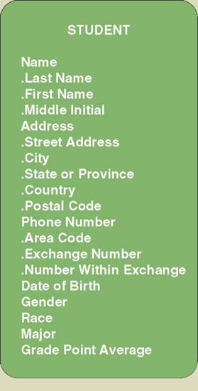
Components of ERD
Attribute:
A descriptive property or characteristic of an entity. Synonyms include element, property, and field.
Just as a physical student can have attributes, such as hair color, height, etc., data entity has data attributes
Compound attribute:
An attribute that consists of other attributes. Synonyms in different data modeling languages are numerous: concatenated attribute, composite attribute, and data structure.

Slide 9
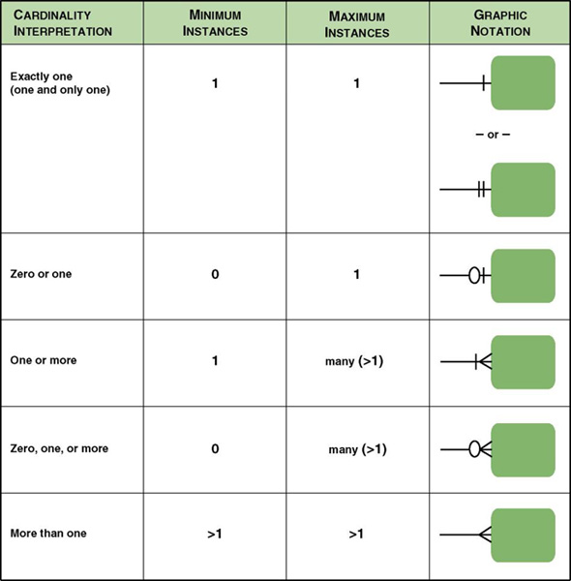
Components of ERD
Cardinality Notations:

Slide 10
Components of ERD
Degree:
The number of entities that participate in the relationship.

Slide 11
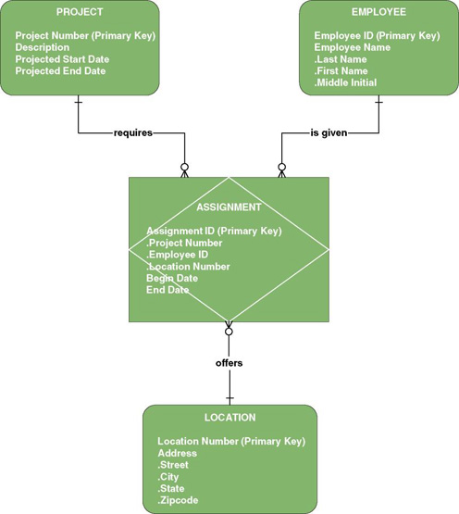
Components of ERD
Associative entity:
An entity that inherits primary key from more than one other entity (called parents).

Slide 12
Components of ERD
Foreign key:
A primary key of an entity that is used in another entity to identify instances of a relationship.
A foreign key is a primary key of one entity that is contributed to (duplicated in) another entity to identify instances of a relationship.
A foreign key always matches the primary key in the another entity
A foreign key may or may not be unique (generally not)
The entity with the foreign key is called the child.
The entity with the matching primary key is called the parent.

Slide 13
Components of ERD
Parent entity
A data entity that contributes one or more attributes to another entity, called the child. In a one-to-many relationship the parent is the entity on the "one" side.
Child entity
A data entity that derives one or more attributes from another entity, called the parent. In a one-to-many relationship the child is the entity on the "many" side.

Slide 14
ERD Steps
The steps involved in creating an ERD are:
Identify the entities.
Determine all significant interactions.
Analyze the nature of the interactions.
Draw the ERD.

Slide 15
What is a Good Data Model?
A good data model is simple.
  Data attributes that describe any given entity should describe only that entity.
  Each attribute of an entity instance can have only one value.
A good data model is essentially non-redundant.
  Each data attribute, other than foreign keys, describes at most one entity.
  Look for the same attribute recorded more than once under different names.
A good data model should be flexible and adaptable to future needs.

